Slide 1
Linear Regression
(Gradient Descent Optimization)

Slide 2

Simple Linear Regression- Cost Function Overview
We know, the linear function that binds the input variable x with the corresponding predicted value of (yˆ) is given by:
𝑦ˆ=𝛽₀ + 𝛽₁𝑥
The cost function (mean square error function) is given by:
n
Table 1: Dataset for SLR containing 3 instances
Independent Variable (x_{i})
1
Dependent Variable (y_{i})
1
1
J(𝛽 , 𝛽 )= Σ(𝑦 − 𝛽 − 𝛽 𝑥 )²
2
2
0 1 i
0 1 i
𝑛
i=1
3
3
The cost function is a function of 𝛽₀ and 𝛽₁.
Let’s plot the cost function as function of 𝛽₁ considering 𝛽₀=0 (for the sake of simplicity i.e., 2D view). Consider the dataset shown in Table 1

Slide 3
Plot of Cost Function of SLR
Table 2: Value of Cost Function 𝐽 𝛽₁ for different values of 𝛽₁ (using dataset shown in Table 1)
J(β1) vs. β1
5
4.5
4
3.5
3
2.5
S.No | 𝛽₁ | n 1 J(𝛽₁)= Σ(𝑦_{i} − 𝛽₁𝑥_{i})² 𝑛 i=1
1 | 1 | _{𝐽 𝛽} ¹ 2 2 2 ₁ = ₃ [ 1 − 1 + (2 − 2) +(3 − 3) ]=0
2 | 0.5 | _{𝐽 𝛽} ¹ 2 2 2 ₁ = ₃ [ 1 − 0.5 + (2 − 1) +(3 − 1.5) ]=1.67
3 | 0 | _{𝐽 𝛽} ¹ 2 2 2 ₁ = ₃ [ 1 − 0 + (2 − 0) +(3 − 0) ]=4.67
4 | 1.5 | 𝐽 𝛽 = ¹ [ 1 − 1.5 ² + (2 − 3)²+(3 − 4.5)²]=1.67 1 ₃
5 | 2 | _{𝐽 𝛽} ¹ 2 2 2 ₁ = ₃ [ 1 − 2 + (2 − 4) +(3 − 6) ]=4.67
J(β1)
2
1.5
1
0.5
0
0 0.5 1 1.5 2 2.5
β1
It is clear from the above function that the cost function is parabolic in shape (bowl-shaped) with one point of minimum where the mean square error is zero.

Slide 4
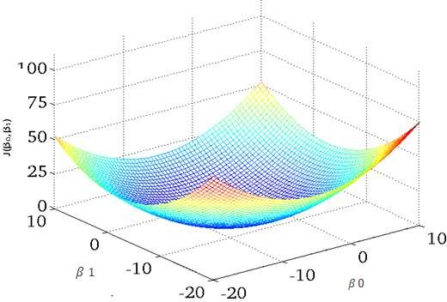
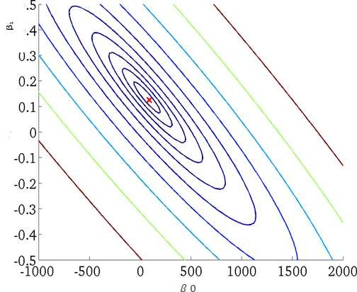
Plot of Cost Function of SLR
(Cost Function as function of ₁)
0
SURFACE PLOT
(BOWL SHAPED CURVE WITH ONLY ONE POINT OF MINIMUM)
CONTOUR PLOT
(SAME COLOR LINES MEAN SAME VALUE OF COST FUNCTION AT DIFFERENT POINTS OF 𝛽₀ AND 𝛽₁)
Contour plot represents a 3-dimensional surface by plotting constant z slices, called contours, on a 2-dimensional format.

Slide 5
Gradient Descent Optimization- Introduction
Gradient Descent is an optimization algorithm for finding a local minimum of a differentiable function.
Gradient descent is simply used to find the values of a function's parameters (coefficients) that minimize a cost function as far as possible. i.e.,
𝑎𝑟𝑔𝑚𝑖𝑛_{(β0,β1,β2……..,βn)} 𝐽(𝛽₀, 𝛽₁, 𝛽₂ … … . . , 𝛽_{n})
It's based on minimizing a convex cost function and tweaks its parameters iteratively to minimize a given function to its local minimum.
It considers gradient of the cost function to tune the parameters.
Gradient can be considered as the slope of a function. The higher the gradient, the steeper the slope and the faster a model can learn. But if the slope is zero, the model stops learning.
In mathematical terms, a gradient is a partial derivative of the function with respect to its inputs.

Slide 6
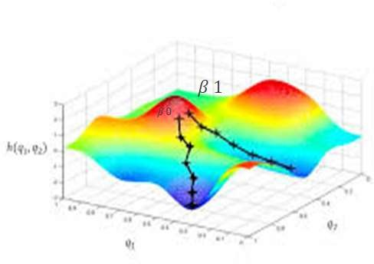
Gradient Descent Optimization- Introduction
The image illustrates the cost function from a top-down view and the black arrows are the steps of gradient descent algorithm.
The algorithm will reach to different local or global minimum depending upon the initial value of 𝛽₀ and 𝛽₁.
The gradient in this context is a vector that contains the direction of the steepest step the algorithm can take and also how long that step should be.

Slide 7
Steps of Gradient Descent Optimization
In order to minimize any differentiable cost function, 𝐽(𝛽₀, 𝛽₁, 𝛽₂ … … . . , 𝛽_{k}) , containing parameters 𝛽₀, 𝛽₁, 𝛽₂ … … . . , 𝛽_{k}, following steps are followed in gradient descent optimization:
Initialize the parameters, 𝛽₀, 𝛽₁, 𝛽₂ … … . . , 𝛽_{k}, to any arbitrary values. Usually, these are set to 0 initial value.
Update the values of parameters 𝛽₀, 𝛽₁, 𝛽₂ … … . . , 𝛽_{k} , using the following equation (until convergence or for fixed number of iterations:
𝛽 = 𝛽 − 𝛼 ^{6(J β )} 𝑓𝑜𝑟 𝑗 = 0,1,2, … … . . 𝑘
j j
6β_{j}
This update must be simultaneous i.e., the RHS of the above equations must be stored in temporary variables for each value of j and then simultaneously assigned.
Here 𝛼 is called the fixed step size that controls the step size and ^{6(J β )} is called the gradient of
6β_{j}
cost function.
Convergence of 𝛽_{j}’s means that there is no change in value of 𝛽_{j} which will happen only when
6(J β ) ₌ ₀
6β_{j}

Slide 8
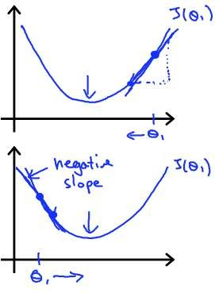
Gradient Descent Optimization- Intuition
The intuition behind gradient descent optimization is that it may start from any arbitrary point it may converge at some local or global minimum.
For instance, consider cost function with only one parameter (θ₁). The shape of cost function is shown in the images 1 and 2.
If we start from θ as shown in figure 1, then gradient ^{6J(θ1)} is
1
6θ₁
positive. Therefore, 𝜃₁ = 𝜃₁ − 𝑝𝑜𝑠𝑖𝑡𝑖𝑣𝑒 𝑞𝑢𝑎𝑛𝑡𝑖𝑡𝑦 . So, it will slowly move towards the minimum point.
If we start from θ as shown in figure 2, then gradient ^{6J(θ1)} is
1
6θ₁
negative. Therefore, 𝜃₁ = 𝜃₁ + 𝑝𝑜𝑠𝑖𝑡𝑖𝑣𝑒 𝑞𝑢𝑎𝑛𝑡𝑖𝑡𝑦 . So, it will again slowly move towards the minimum point.

Slide 9
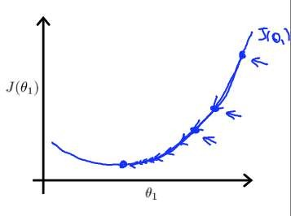

Learning Rate in Gradient Descent
Why is learning rate fixed?
Gradient descent algorithm, can converge to a local minimum, even with fixed learning rate.
1 1
1
As we approach a local minimum, gradient descent will automatically take smaller steps.
So, no need to decrease learning rate over time.

Slide 10
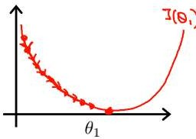
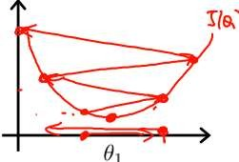
Learning Rate in Gradient Descent Contd…
What if learning rate is too small?
If learning rate is small, then gradient descent will take a lot of time to converge (as shown in the figure).
What if learning rate is too large?
If learning rate is too large, then gradient descent can overshoot the minimum.
It may fail to converge or even diverge (as shown in figure below).

Slide 11
Gradient Descent for Simple Linear Regression (SLR)
The cost function (mean square error function) for simple linear regression is dependent upon two parameters 𝛽₀ and 𝛽₁ and is given by:
n
1
𝐽 𝛽 ,𝛽 = Σ(𝑦 −𝛽 − 𝛽 𝑥 )²
0 1 i 0
1 i
2𝑛
i=1
where n are total number of training examples and dividing cost function by 2 will not affect the minimization process.
The gradient of the cost function is the partial derivative of cost function with respect to input parameters 𝛽₀ and 𝛽₁ and is computed as below:
𝜕 𝜕
n n
1
Σ(𝑦 −𝛽 − 𝛽 𝑥 )²
1
= × 2 Σ(𝑦 −𝛽 − 𝛽 𝑥 ) × (−1)
𝐽 𝛽 ,𝛽 =
0 1
i 0
1 i
i 0 1 i
𝜕𝛽₀ 𝜕𝛽₀ 2𝑛
2𝑛
i=1
i=1
Therefore,
𝝏
𝑱 𝜷 ,𝜷 = ^{𝟏} ∑^{𝒏} (𝜷 + 𝜷 𝒙 − 𝒚 )
𝝏𝜷_{𝟎}
𝟎 𝟏 𝒊=𝟏 𝟎 𝟏 𝒊 𝒊
𝒏

Slide 12
Gradient Descent for SLR Contd…..
6
6 1 _{∑n}
1
Similarly, 𝐽 𝛽 ,𝛽
=
(𝑦 −𝛽 − 𝛽 𝑥 )² = × 2 ∑^{n} (𝑦 −𝛽 − 𝛽 𝑥 ) × (−𝑥 )
6β₁
0 1
6β₁ 2n
i=1 i 0 1 i i=1 i 0 1 i i
2n
Therefore,
𝝏
𝑱 𝜷 ,𝜷 = ^{𝟏} ∑^{𝒏} (𝜷 + 𝜷 𝒙 − 𝒚 ) × (𝒙 )
𝟎 𝟏 𝒊=𝟏 𝟎 𝟏 𝒊 𝒊 𝒊
𝝏𝜷_{𝟎} 𝒏
The gradient descent optimization for Simple Linear Regression is summarized as below:
Initialize 𝛽₀ =0 and 𝛽₁ = 0
Update 𝛽₀ and 𝛽₁ until convergence or for fixed number of iterations using following equations:
𝑡𝑒𝑚𝑝0 ≔ 𝛽₀ − _{n} × _{i=1}(𝛽₀ + 𝛽₁𝑥_{i} − 𝑦_{i})
α
∑n
α
∑n
𝑡𝑒𝑚𝑝1 ≔ 𝛽₁ − _{n} ×
i=1 ^{𝛽}0 ^{+ 𝛽}1^{𝑥}i ^{− 𝑦}i
× 𝑥_{i}
𝛽₀ ≔ 𝑡𝑒𝑚𝑝0
𝛽₁ ≔ 𝑡𝑒𝑚𝑝1

Slide 13
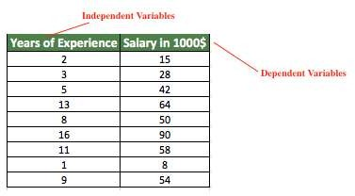
Gradient Descent for SLR- Example
Consider the following dataset that shows the salary of an employee as function of years of Experience. For the given dataset show first two iterations of gradient descent
optimization for linear regression. Initialize ₀ =0 and and consider learning rate as 0.01
1

Slide 14
Gradient Descent for SLR- Example
Initialize, ₀ =0 and
1
S.No | xi | yi | x_{i}y_{i} | x_{i} 2
1 | 2 | 15000 | 30000 | 4
2 | 3 | 28000 | 84000 | 9
3 | 5 | 42000 | 210000 | 25
4 | 13 | 64000 | 832000 | 169
5 | 8 | 50000 | 400000 | 64
6 | 16 | 90000 | 1440000 | 256
7 | 11 | 58000 | 638000 | 121
8 | 1 | 8000 | 8000 | 1
9 | 9 | 54000 | 486000 | 81
Total | 68 | 409000 | 4128000 | 730
We know, in each iteration and are updated as follows:
0
1
α
∑n
𝑡𝑒𝑚𝑝0 ≔ 𝛽₀ − _{n} × _{i=1}(𝛽₀ + 𝛽₁𝑥_{i} − 𝑦_{i})
α
∑n
𝑡𝑒𝑚𝑝1 ≔ 𝛽₁ − _{n} ×
i=1 ^{𝛽}0 ^{+ 𝛽}1^{𝑥}i ^{− 𝑦}i
× 𝑥_{i}
𝛽₀ ≔ 𝑡𝑒𝑚𝑝0
𝛽₁ ≔ 𝑡𝑒𝑚𝑝1

Slide 15
Gradient Descent for SLR- Example Contd…
First Iteration:
α
∑n
S.No | xi | yi | x_{i}y_{i} | x_{i} 2
1 | 2 | 15000 | 30000 | 4
2 | 3 | 28000 | 84000 | 9
3 | 5 | 42000 | 210000 | 25
4 | 13 | 64000 | 832000 | 169
5 | 8 | 50000 | 400000 | 64
6 | 16 | 90000 | 1440000 | 256
7 | 11 | 58000 | 638000 | 121
8 | 1 | 8000 | 8000 | 1
9 | 9 | 54000 | 486000 | 81
Total | 68 | 409000 | 4128000 | 730
𝑡𝑒𝑚𝑝0 ≔ 𝛽₀ − _{n} × _{i=1}(𝛽₀ + 𝛽₁𝑥_{i} − 𝑦_{i})
𝑡𝑒𝑚𝑝0 ≔ 0 −
0.01
0 × 9 + 0 × 68 − 409000
= 454.44
9
𝑡𝑒𝑚𝑝1 ≔ 𝛽 − ^{α} × ∑^{n} 𝛽 + 𝛽 𝑥 − 𝑦 × 𝑥
1 i=1
0 1 i i i
n
0.01
𝑡𝑒𝑚𝑝1 ≔ 0 − 0 × 68 + 0 × 730 − 4128000
= 4586.67
9
𝜷 = 𝟒𝟓𝟒. 𝟒𝟒
𝟎
𝜷_{𝟏} = 𝟒𝟓𝟖𝟔. 𝟔𝟕

Slide 16
Gradient Descent for SLR- Example Contd…
Second Iteration:
α
∑n
S.No | xi | yi | x_{i}y_{i} | x_{i} 2
1 | 2 | 15000 | 30000 | 4
2 | 3 | 28000 | 84000 | 9
3 | 5 | 42000 | 210000 | 25
4 | 13 | 64000 | 832000 | 169
5 | 8 | 50000 | 400000 | 64
6 | 16 | 90000 | 1440000 | 256
7 | 11 | 58000 | 638000 | 121
8 | 1 | 8000 | 8000 | 1
9 | 9 | 54000 | 486000 | 81
Total | 68 | 409000 | 4128000 | 730
𝑡𝑒𝑚𝑝0 ≔ 𝛽₀ − _{n} × _{i=1}(𝛽₀ + 𝛽₁𝑥_{i} − 𝑦_{i})
𝑡𝑒𝑚𝑝0 ≔ 454.44 −
= 557.79
0.01
454.44 × 9 + 4586.67 × 68 − 409000
9
α
∑n
𝑡𝑒𝑚𝑝1 ≔ 𝛽₁ − _{n} ×
i=1 ^{𝛽}0 ^{+ 𝛽}1^{𝑥}i ^{− 𝑦}i
× 𝑥_{i}
𝑡𝑒𝑚𝑝1
≔ 4586.67 −
= 5418.70
0.01
454.44 × 68 + 4586.67 × 730 − 4128000
9
𝜷_{𝟎} = 𝟓𝟓. 𝟕𝟗
𝜷_{𝟏} = 𝟓𝟒𝟏𝟖. 𝟕𝟎

Slide 17
Gradient Descent Optimization for Multiple Linear Regression (MLR)
A multiple linear regression model with k independent predictor variables x₁,x₂...,x_{k} predicts the output variable as:
𝑦^{ˆ} = 𝛽₀ + 𝛽₁𝑥₁ + 𝛽₂𝑥₂ + 𝛽₃𝑥₃ + ⋯ … … … . . +𝛽_{k}𝑥_{k}
The cost function (mean square error function) is given by:
n
1
𝐽 = Σ(𝑦 − 𝛽 − 𝛽 𝑥 − 𝛽 𝑥 − 𝛽 𝑥 − ⋯ … … … . . −𝛽 𝑥
₎2
2𝑛
i 0 1 i1 2 i2 3 i3 k ik
i=1
Gradient of the cost function with respect to input parameters is given by:
n
𝜕𝐽 1
= _{𝑛} Σ(𝛽₀ + 𝛽₁𝑥_{i1} + 𝛽₂𝑥_{i2} + 𝛽₃𝑥_{i3} + ⋯ … … … . . +𝛽_{k}𝑥_{ik} − 𝑦_{i})
i=1
𝜕𝛽
0

Slide 18
Gradient Descent Optimization for MLR
Similarly,
6J
= ¹ ∑^{n} (𝛽 + 𝛽 𝑥
+ 𝛽 𝑥
+ 𝛽 𝑥
+ ⋯ … … … . . +𝛽 𝑥
— 𝑦 ) × 𝑥
6β₁ n
i=1 0 1 i1
2 i2
3 i3
k ik
i
i1
6J
= ¹ ∑^{n} (𝛽 + 𝛽 𝑥 + 𝛽 𝑥 + 𝛽 𝑥 + ⋯ … … … . . +𝛽 𝑥 − 𝑦 ) × 𝑥
6β₂ n
i=1 0 1 i1 2 i2 3 i3 k ik i i1 n
𝜕𝐽 1
𝜕𝛽
= _{𝑛} Σ(𝛽₀ + 𝛽₁𝑥_{i1} + 𝛽₂𝑥_{i2} + 𝛽₃𝑥_{i3} + ⋯ … … … . . +𝛽_{k}𝑥_{ik} − 𝑦_{i}) × 𝑥_{i3}
3
i=1
⋮
⋮
⋮
In general,
𝝏𝑱
= ^{𝟏} ∑^{𝒏} (𝜷 + 𝜷 𝒙
+ 𝜷 𝒙
+ 𝜷 𝒙
+ ⋯ … … … . . +𝜷 𝒙
— 𝒚 ) × 𝒙
𝝏𝜷_{𝒋} 𝒏
𝒊=𝟏 𝟎 𝟏 𝒊𝟏
𝟐 𝒊𝟐
𝟑 𝒊𝟑
𝒌 𝒊𝒌
𝒊
𝒊𝒋

Slide 19
Gradient Descent Optimization for MLR
The gradient descent optimization for Multiple Linear Regression is summarized as below: 1. Initialize 𝛽₀ =0 , 𝛽₁ = 0, 𝛽₂ = 0,…………………………… 𝛽_{k} = 0
2. Update parameters until convergence or for fixed number of iterations using following equation:
n
𝛼
𝛽_{j} = 𝛽_{j} − _{𝑛} Σ(𝛽₀ + 𝛽₁𝑥_{i1} + 𝛽₂𝑥_{i2} + 𝛽₃𝑥_{i3} + ⋯ … … … . . +𝛽_{k}𝑥_{ik} − 𝑦_{i}) × 𝑥_{ij}
i=1
For j=0,1,2,3……………..k
Where x_{i0}=1 and k are the total number of iterations

Slide 20
Gradient Descent Optimization for MLR- Example
Consider the following dataset that shows the Stock Index Price as function of Interest Rate and Unemployment rate. For the given dataset show first iteration of gradient descent optimization for linear regression. Initialize 𝛽₀ =0 , 𝛽₁ = 0, , 𝛽₂ = 0 and consider learning rate as 0.01
Interest Rate (x_{i1}) | Unemployment rate (x_{i2}) | Stock Index Price (y_{i})
2.75 | 5.3 | 1464
2.5 | 5.3 | 1394
2.25 | 5.5 | 1159
2 | 5.7 | 1130
2 | 5.9 | 1075
2 | 6 | 1047
1.75 | 5.9 | 965
1.75 | 6.1 | 719

Slide 21
Gradient Descent Optimization for MLR- Example
Initially, 𝛽₀ =0 , 𝛽₁ = 0, , 𝛽₂ = 0
Iteration I:
n
S.No | (x_{i1}) | (x_{i2}) | (y_{i}) | ^{x}i1^{x}i2 | ^{x}i1^{y}i | ^{x}i2^{y}i | (x_{i1})² | (xi2_{i})²
1 | 2.75 | 5.3 | 1464 | 14.575 | 4026 | 7759.2 | 7.5625 | 28.09
2 | 2.5 | 5.3 | 1394 | 13.25 | 3485 | 7388.2 | 6.25 | 28.09
3 | 2.25 | 5.5 | 1159 | 12.375 | 2607.7 5 | 6374.5 | 5.0625 | 30.25
4 | 2 | 5.7 | 1130 | 11.4 | 2260 | 6441 | 4 | 32.49
5 | 2 | 5.9 | 1075 | 11.8 | 2150 | 6342.5 | 4 | 34.81
6 | 2 | 6 | 1047 | 12 | 2094 | 6282 | 4 | 36
7 | 1.75 | 5.9 | 965 | 10.325 | 1688.7 5 | 5693.5 | 3.0625 | 34.81
8 | 1.75 | 6.1 | 719 | 10.675 | 1258.2 5 | 4385.9 | 3.0625 | 37.21
Total | 17 | 45.7 | 8953 | 96.4 | 19569. 75 | 50666. 8 | 37 | 261.75
𝛼
— Σ(𝛽 + 𝛽 𝑥
𝑡𝑒𝑚𝑝0 ≔ 𝛽
0
+ 𝛽 𝑥 − 𝑦
𝑛
0 1 i1 2 i2 i
0.01
i=1
𝑡𝑒𝑚𝑝0 ≔ 0 −
8
8 × 0 + 17 × 0 + 45.7 × 0 − 8953 = 11.19
𝑡𝑒𝑚𝑝1 ≔ 𝛽
— α
∑n
(𝛽 + 𝛽 𝑥 + 𝛽 𝑥 − 𝑦_{i} × 𝑥_{i1})
1
n
i=1 0 1 i1 2 i2
𝑡𝑒𝑚𝑝1 ≔ 0 − ^{0.01} 17 × 0 + 37 × 0 + 96.4 × 0 − 19569.75 = 24.46
8
— α
𝑡𝑒𝑚𝑝2 ≔ 𝛽
∑n
(𝛽 + 𝛽 𝑥 + 𝛽 𝑥 − 𝑦_{i} × 𝑥_{i2})
2
n
i=1 0 1 i1 2 i2
𝑡𝑒𝑚𝑝2 ≔ 0 −
0.01
8
45.7 × 0 + 96.4 × 0 + 261.75 × 0 − 50666.8 = 63.33
𝛽₀ =11.19 , 𝛽₁ = 24.46, , 𝛽₂ = 63.33

Slide 22
Linear Regression
(Problems & Solutions)

Slide 23
Problem 1: Multicollinearity
In regression, "multicollinearity" refers to predictors that are correlated with other predictors.
Multicollinearity occurs when our model includes multiple factors that are correlated not just to your response variable, but also to each other.
In other words, it results when we have factors that are a bit redundant.
Multicollinearity increases the standard errors of the coefficients.
Increased standard errors in turn means that coefficients for some independent variables may be found not to be significantly different from 0.
In other words, by overinflating the standard errors, multicollinearity makes some variables statistically insignificant when they should be significant.

Slide 24
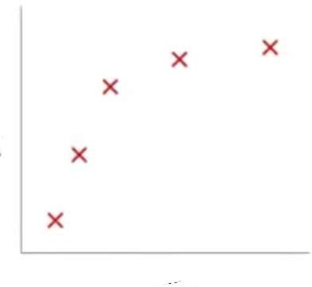
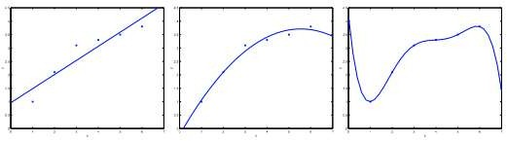
Problem 2 & 3: Underfitting & Overfitting
In order to understand the concept of overfitting and underfitting, consider following example (shown in Figure 1(a)) where we have to fit a regression function (hypothesis) that can predict the value of output variable (y) given input variable (x).
Let us fit three regression hypothesis on the data as shown in Figure 1(b), 1(c), and 1 (d)
Figure 1(a) | Figure 1(b) | Figure 1(c) | Figure 1(d)
 | 𝑦∧= 𝛽₀ + 𝛽₁𝑥 (Underfit) | 𝑦∧ = 𝛽₀ + 𝛽₁𝑥 + 𝛽₂𝑥² (Good Fit) | 𝑦∧= 𝛽₀ + 𝛽₁𝑥 + 𝛽₂𝑥² + 𝛽₃𝑥³ + 𝛽₄ 𝑥⁴ (Overfit)

Slide 25
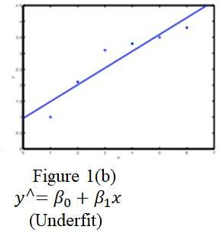
Underfitting
The figure 1(a) shows the result of fitting a linear hypothesis
𝑦∧= 𝛽₀ + 𝛽₁𝑥 .
We can see that the data doesn’t really lie on straight line, and so the fit is not very good.
The figure shows an instance of underfitting—in which the data clearly shows structure not captured by the model.
Underfitting, or high bias, is when the form of our hypothesis function h maps poorly to the trend of the data.
It is usually caused by a function that is too simple or uses too few features.
Underfitting can be solved by increasing the number of features in our training data.

Slide 26
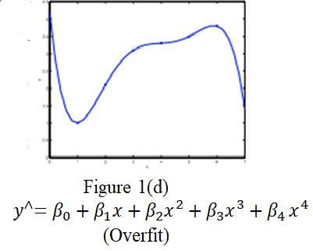
Overfitting
The figure 1(d) shows the result of fitting a high order
polynomial hypothesis
3
∧ 2
4.
0 1 2
3 4
The figure is an example of overfitting.
Overfitting, or high variance, is caused by a hypothesis function that fits the available data but does not generalize well to predict new data.
It is usually caused by a complicated function that creates a lot of unnecessary curves and angles unrelated to the data.
For example, a quadratic fit shown in Figure 1(c) (slide number 3) is a good fit as it fits well to data and generalizes well.

Slide 27
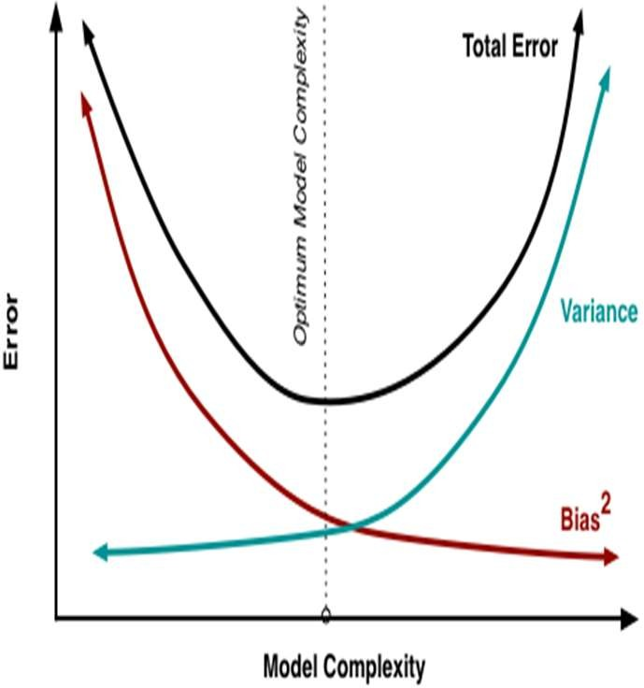
Bias and Variance Tradeoff
If we have less number of features i.e., low model complexity, the fit is underfit with high bias error.
the bias is an error from a faulty assumption in the learning algorithm.
when the bias is too large, the algorithm would be able to correctly model the relationship between the features and the target outputs.
As we keep on increasing the model complexity (number of features) bias decreases but variance increases (overfit).
Variance is an error resulting from fluctuations int he training dataset.
A high value for variance would cause the algorithm may capture the most data points put would not be generalized enough to capture new data points.
The tradeoff between bias and variance can be controlled using controlling the complexity of model.

Slide 28
Solutions to Regression Problems
The problems of multicollinearity, and overfitting can be controlled by handling the complexity of the model.
The model complexity can be controlled using any of these features:
Remove highly correlated predictors from the model
Manually select which features to keep.
Use feature selection methods to choose features that maximizes relevancy or minimizes redundancy.
Use feature extraction techniques models such as PCA, SVD, and LDA.
Regularization
Keep all the features, but reduce the magnitude of parameters
Regularization works well when we have a lot of slightly useful features.

Slide 29
Regularization/ Shrinkage
Regularization is a technique used for tuning the function by adding an additional penalty term in the error function that reduces the magnitude of parameters .
The additional term controls the excessively fluctuating function such that the coefficients don’t take extreme values.
This technique of keeping a check or reducing the value of error coefficients are called shrinkage methods.
If we have overfitting from our hypothesis function (as shown in Figure 1(d)), we can reduce the weight of some of the terms in our function carry by increasing their cost.

